Slide 1
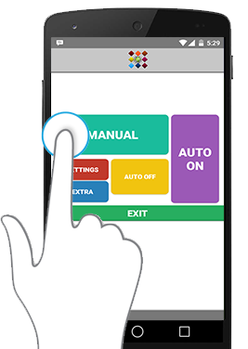
Project Apheleia
By : Mohammad Noman

Slide 2
Overview
Apheleia is a name in Greek mythology, It was used to show the simplicity of the good old times, and this is the main theme in the application.
Nowadays, many parents give their kids smartphones, That is because they can’t be with them all the time due to work.
So how about a simple way , to keep tracking of your kids , without the need to bother by calling, especially at work, or due to some other reasons.
Here is where Apheleia comes in, with a two-part application , that can help many users to get these informations in a easy and simple way.

Slide 3
Process
Apheleia is a Two-part application, One part is kept with the Child ( Apheleia S ) and the other one with the Adult ( Apheleia M ).
The main workout of the applications is:
1- Apheleia S gets the location updates from the GPS coordinates and then checks if there was a change in location then it send the location to the server.
2- Apheleia M have two modes, Manual mode means fetching the location one time only from the server and displaying the location using ESRI maps.
The other mode Auto mode, every a period of time working as a background service, it fetch the location from the server, and if there were any updates it will give a notification to the user.
3- There are also features that help using the Main application like voice commands, Voice notification and gestures, also implementation of Android Wear to interact with the main application.

Slide 4
The Next Step
There are some points that will be improved upon in the next updates:
* Improving the server side and the multi-user structure , also implementing a simple GCM mode so that the user will get the notifications directly from the server.
* Improving Apheleia S and adding more features for the optimizations.
* Making the updates time custom and user selected instead of 60sec.
* Adding another extra option , and that is finding the nearest route from the Parent to the Kid, using ESRI maps and GPS coordinates .
* Optimizing the design and functions to support an even wider range of android smartphones.

